Slide 1
Salary Prediction Cleaning
By: Spencer Reno

Slide 2
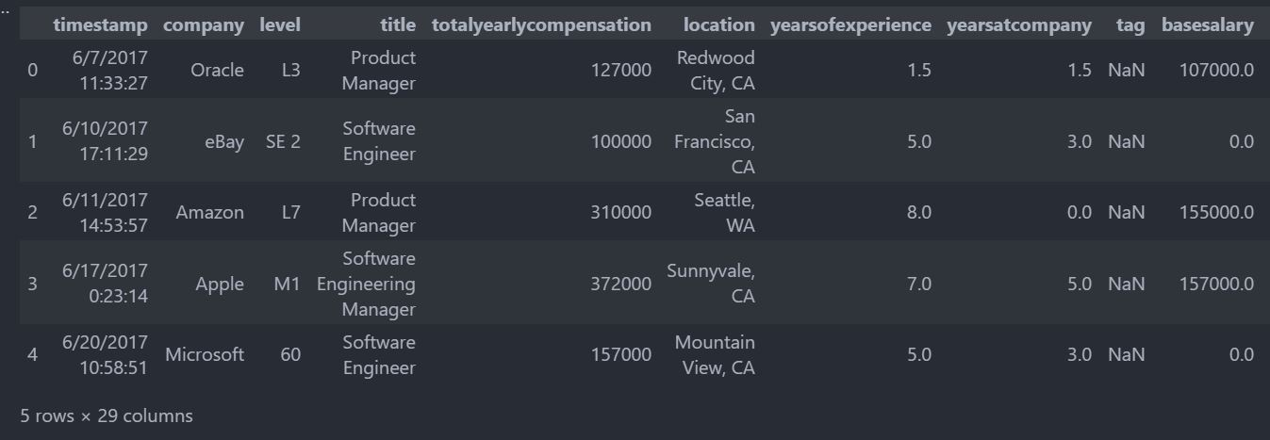
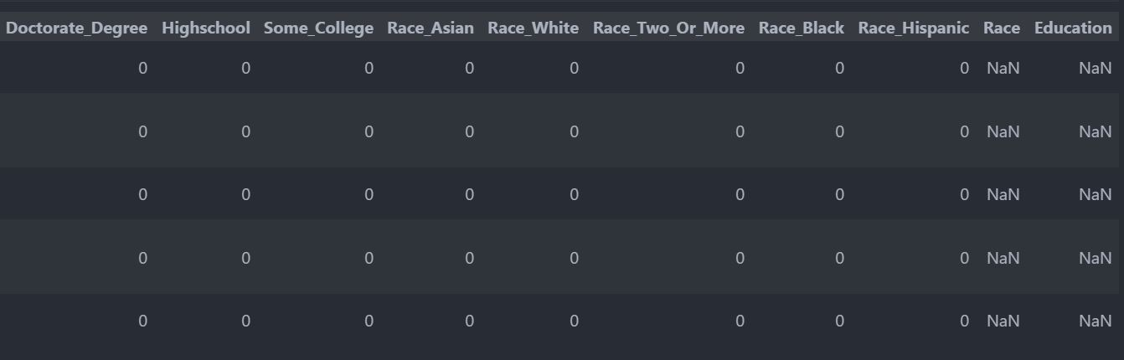

Slide 3
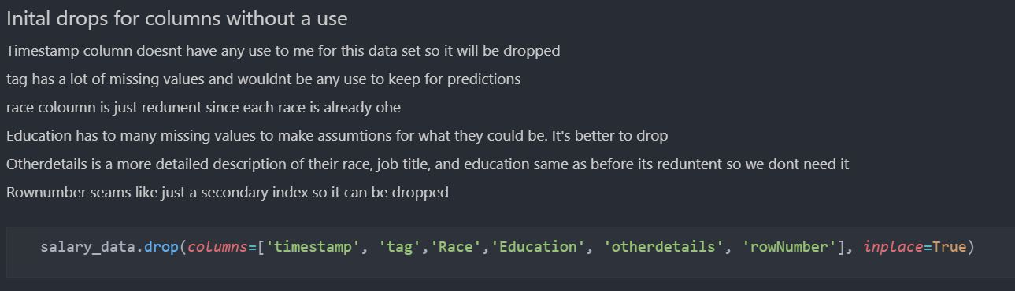
Timestamp was dropped as I won't be using time for visualizations, and it’s not needed for predictions.
The tag column had a lot of missing values and didn’t add any value to our predictions.
The race and education columns had a lot of null values and there are other correlated one hot encoded columns within the dataset.
Otherdetails and RowNumber were redundant columns with information already specified else where in the data.

Slide 4
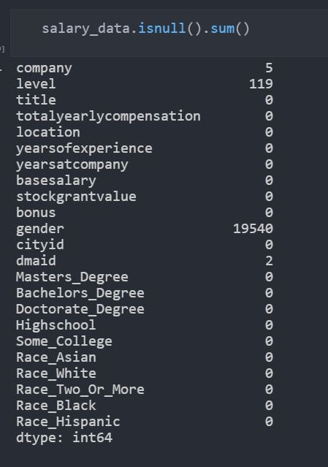
There were a lot of data points that were missing within this data and were handled after this point in many interesting ways.

Slide 5
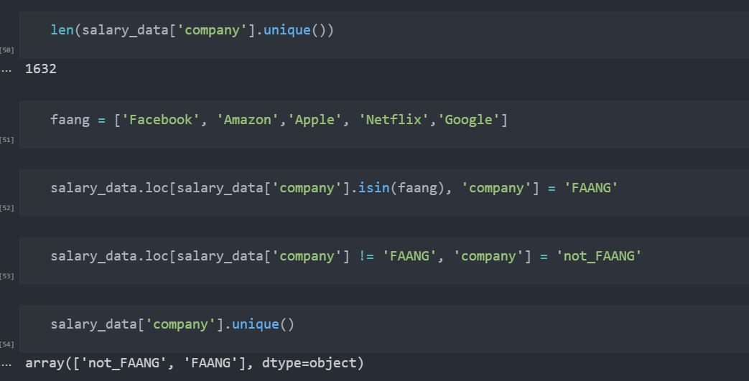
5 Missing Values in Company column
Since there are 1632 different companies, I changed all companies within FAANG to FAANG and others to not_FAANG

Slide 6
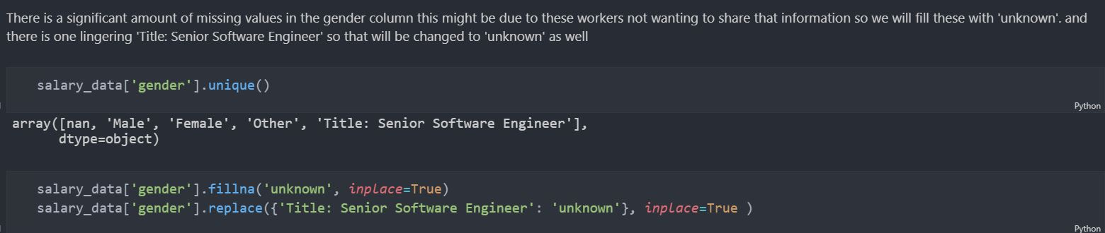
Missing values within gender column most likely are due to workers not wanting to share that information or other unknown reasons
Filled all missing values with “unknown”
Replaced other inconsistencies within the column

Slide 7
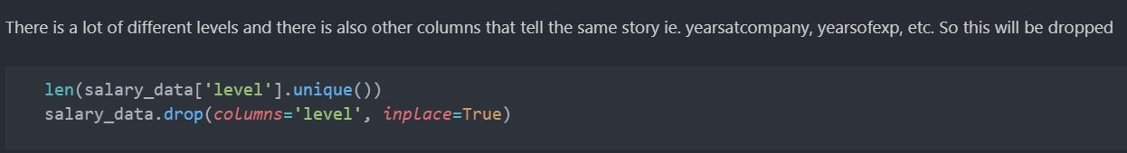
levels column this was focused on trying to specify a worker's job position or ‘level’ at the company.
There are other columns within the data set that relay a similar or same story/idea. So, to limit the redundancy this column was dropped.

Slide 8
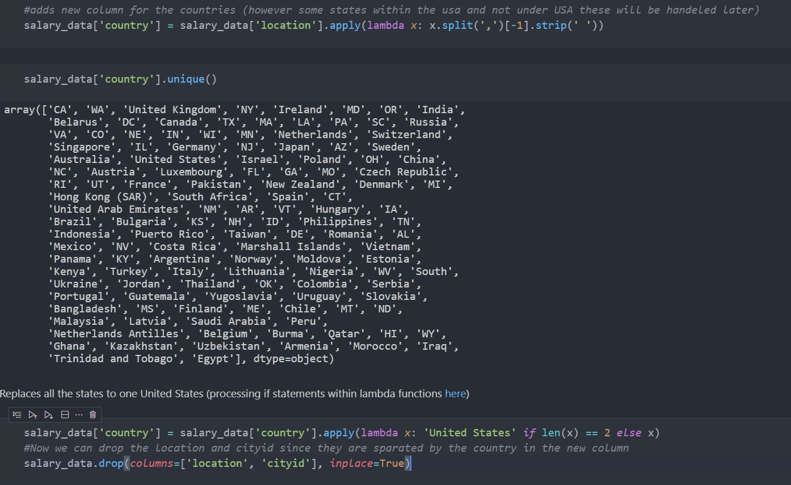
Split country column values by the last value to get the countries
Fix inconsistent states abv that were listed to be under United States
Dropped Lactation and cityId columns as they are no longer needed

Slide 9
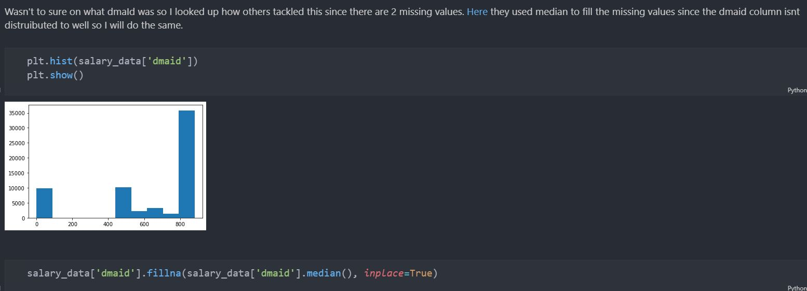
After research I found how others have combatted the missing data within this column and found that they used median to fill the missing values to help with the gap in the hist plot.

Slide 10
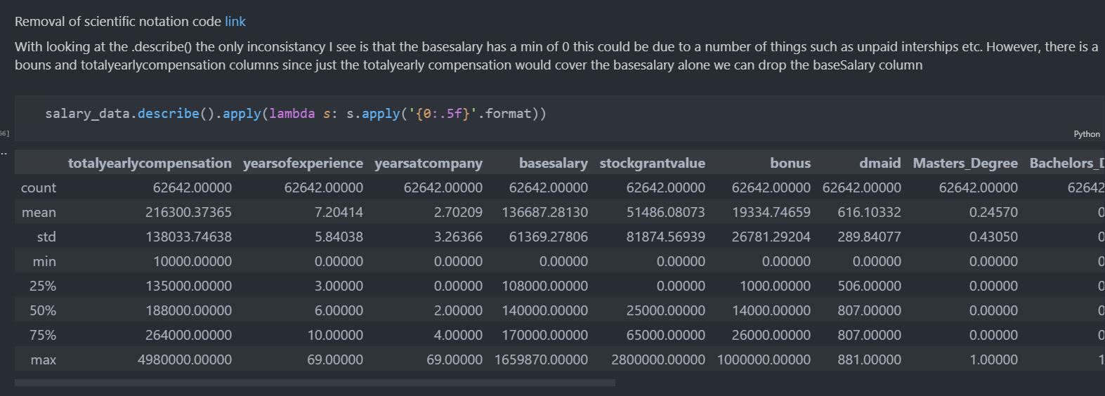
Two inconsistencies that stand out are Base Salary min is 0, And a major outlier within Years at company.
Since just the totalyearlycompensation would cover the basesalary alone we can drop the baseSalary column.
It’s very unlikely that someone would stay at the same job for 69 years. I dropped this row to not skew any of our data later

Slide 11
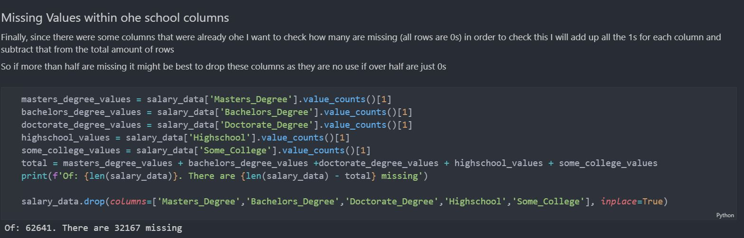
Since we have pre-Ohe columns I checked these for any missing values (all columns being 0)
After adding up all the rows that didn’t contain a 1. This showed that more than half of the data for both school and race were missing.
a base KNN model ran in a test with all columns the run time took 6 minutes and gave a score of Training: 0.852341136615955 Testing: 0.7662578155179134.
With all the pre-ohe dropped the scores increased to a train: 0.86 and test: 0.78 and only took 56 seconds.

Slide 12
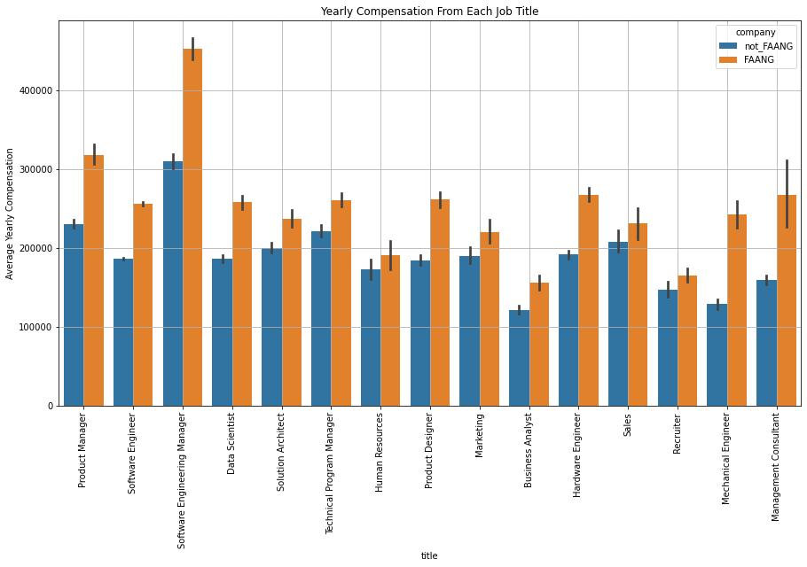

Slide 13
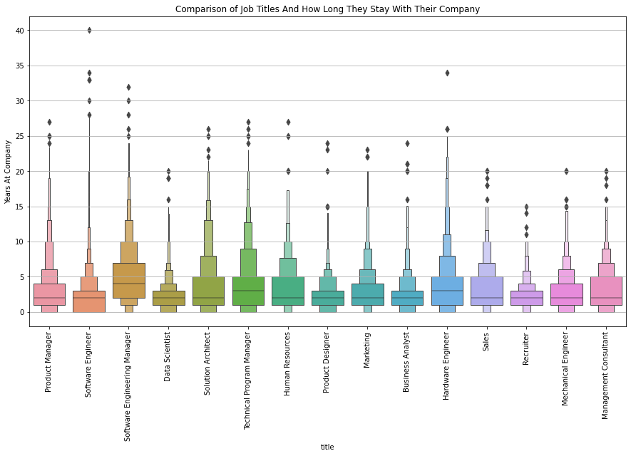

Slide 14
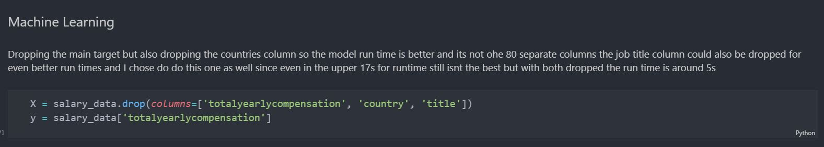
Model Preparations
While the country and title columns are nice to have for data visualizations. They increased the run times for models since it would have to one hot encode each of the 80 countries, and each job title. So, for the machine learning preparations these were dropped.

